Slide 1
Posts App
By Rania Deiri

Slide 2
Login

Slide 3
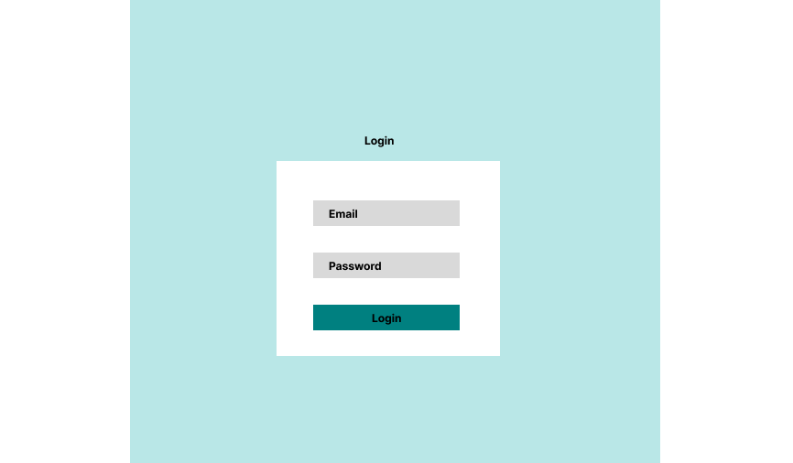

Slide 4
Home Page

Slide 5
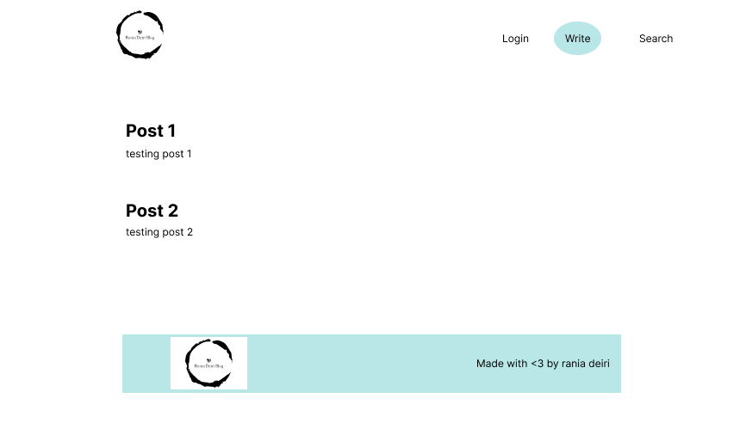

Slide 6
Write a Post

Slide 7
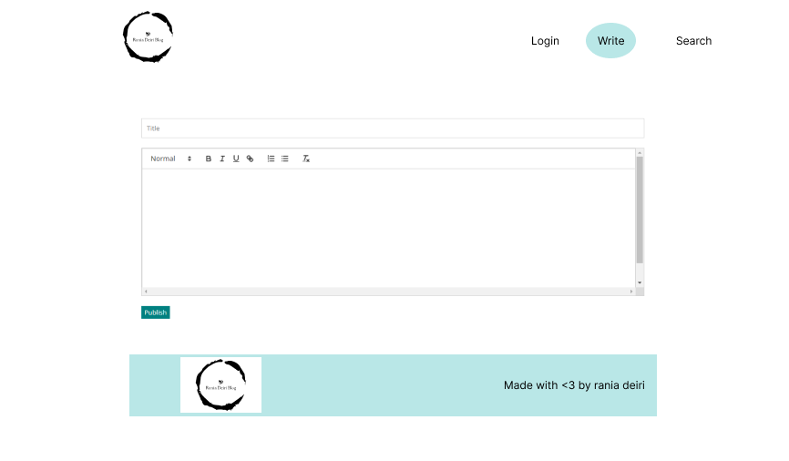

Slide 8
Search Posts

Slide 9
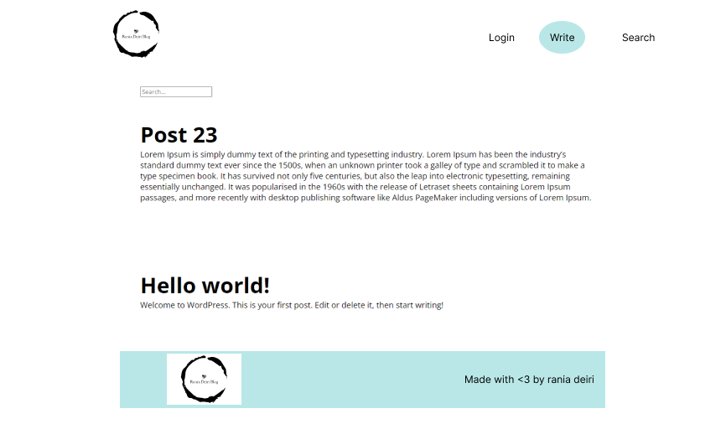

Slide 10
Single Post

Slide 11
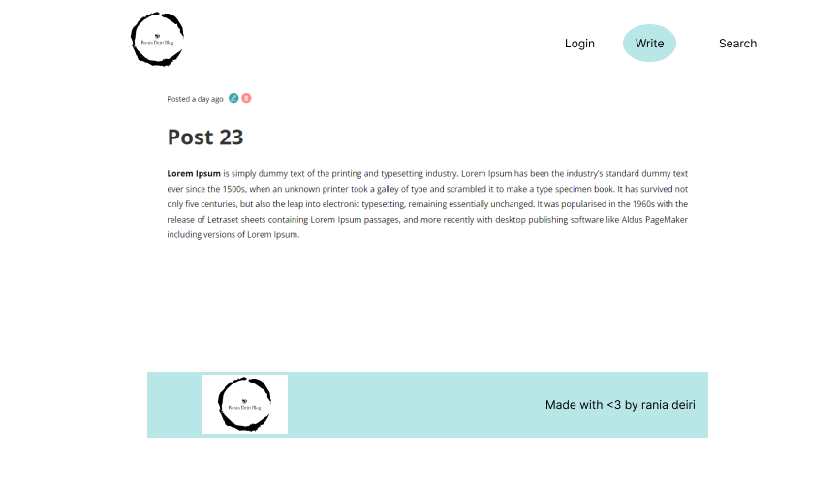

Slide 12
Edit Post

Slide 13
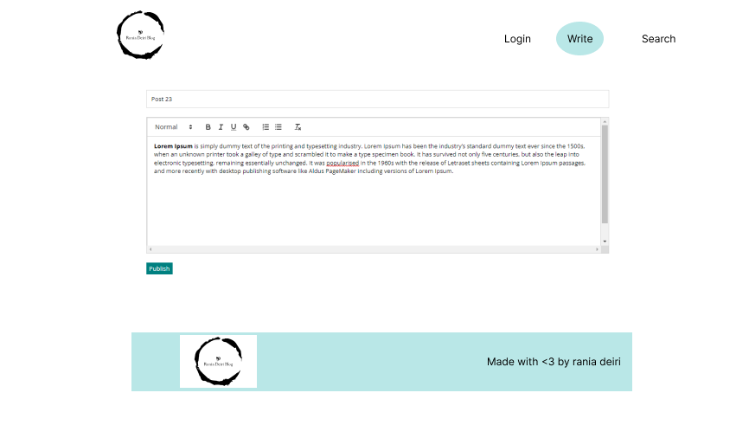

Slide 14
References:
Style Figma File: https://www.figma.com/file/00tzzsH98pg7e84HuFXsFq/Posts-App?type=design&node-id=1%3A86&mode=design&t=lez2b9zrRKdC78w2-1

